Slide 1
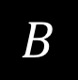
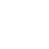
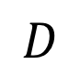
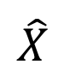
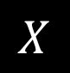
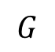
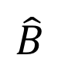
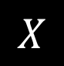
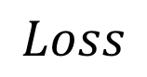
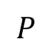
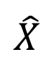
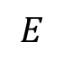
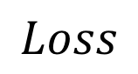
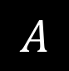
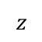
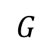
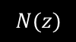
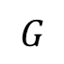
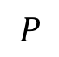
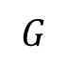
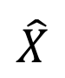
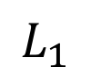
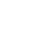
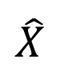
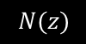
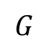
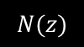
$$G$$
Input Image
$$G$$
$$z$$
$$\hat{X}$$
Ground truth output
$$N(z)$$
$$\hat{X}$$
Network output
$$Loss$$
Loss
(a) Generating a random image on the manifold
$$P$$
$$X$$
Deep network
Target latent distribution
(b) Projecting image x
into the latent space z
Sample from distribution
$$Loss$$
$$L_{1}$$
$$G$$
$$P$$
$$G$$
$$A$$
$$N(z)$$
$$\hat{X}$$
$$X$$
$$z$$
$$\hat{X}$$
$$G$$
$$\hat{B}$$
$$E$$
$$z$$
$$N(z)$$
(a) Generating a random image on the manifold
(b) Projecting image x into the latent space z
$$D$$
$$B$$
(d) Training cLR-GAN

Slide 2
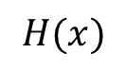
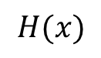
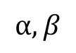
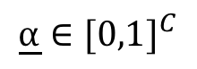
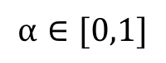
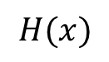
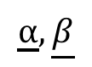
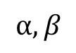
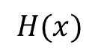
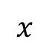
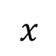
$$H(x)$$
$$H(x)$$
$$⍺,β$$
$$x$$
$$x$$
AdaIn
Vanilla ResNet (No conditioning)
Adaptive Instance Normalization
$$⍺∈[0,1]$$
$$⍺,β$$
+
$$H(x)$$
Scale
$$H(x)$$
Scale+Shift
$$x$$
$$x$$
Blockwise Gating (Scale only)
Blockwise Gating (Scale+Shift)
$$\underline{⍺}∈{[0,1]}^{C}$$
$$\underline{⍺},\underline{β}$$
$$H(x)$$
Scale
$$H(x)$$
Scale+Shift
$$x$$
$$x$$
Channelwise Gating (Scale only)
Channelwise Gating (Scale+Shift)

Slide 3
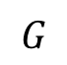
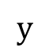
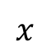
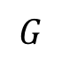
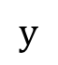
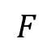
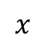
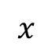
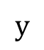
$$G$$
$$x$$
$$x$$
$$x$$
$$G$$
$$G$$
$$G$$
$$y$$
$$y$$
$$F$$
$$⍺,β$$
$$y$$
1-hot Concatenation
(Input only)
1-hot Concatenation
(All layers)
Gated Conditioning
(Ours)

Slide 4
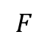
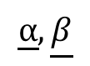
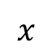











$$x$$
$$x$$
$$x$$
$$G$$
$$G$$
$$G$$
$$y$$
$$y$$
$$y$$
$$⍺,β$$
$$F$$
1-hot Concatenation (Input only)
1-hot Concatenation (All layers)
Gated Conditioning [Ours]
Class label injection
$$⍺∈[0,1]$$
$$\underline{⍺}∈{[0,1]}^{C}$$
$$H(x)$$
$$H(x)$$
Scale
$$H(x)$$
Scale
$$x$$
$$x$$
$$x$$
Vanilla ResNet (No conditioning)
Blockwise Gating (Scale only)
Channelwise Gating (Scale only) [Ours]
$$⍺,β$$
$$\underline{⍺},\underline{β}$$
$$⍺,β$$
$$H(x)$$
$$H(x)$$
Scale+Shift
$$H(x)$$
Scale+Shift
$$x$$
AdaIn
$$x$$
$$x$$
Adaptive Instance Normalization
Blockwise Gating (Scale+Shift)
Channelwise Gating (Scale+Shift)
Variants of Conditional Gating

Slide 5




$$A$$
$$\hat{B}$$
$$x$$
$$x$$
$$G$$
$$G$$
$$G$$
$$y$$
$$y$$
$$y$$
Gating parameters
Naive Concatenation
(Input only)
Naive Concatenation
(All layers)
$$F$$
Gated Conditioning [Ours]
Class label injection
$$⍺∈[0,1]$$
$$\underline{⍺}∈{[0,1]}^{C}$$
$$H(x)$$
$$H(x)$$
Scale
$$H(x)$$
Scale
$$x$$
$$x$$
$$x$$
Vanilla ResNet (No conditioning)
Blockwise Gating (Scale only)
Channelwise Gating (Scale only) [Ours]
$$⍺,β$$
$$\underline{⍺},\underline{β}$$
$$⍺,β$$
$$H(x)$$
$$H(x)$$
Scale+Shift
$$H(x)$$
Scale+Shift
$$x$$
AdaIn
$$x$$
$$x$$
Adaptive Instance Normalization
Blockwise Gating (Scale+Shift)
Channelwise Gating (Scale+Shift)
Variants of Conditional Gating

Slide 6
















$$⍺$$
$$β$$
$$⍺∈[0,1]$$
$$H(x)$$
$$H(x)$$
$$H(x)$$
$$x$$
$$x$$
$$x$$
Vanilla ResNet (No conditioning)
Blockwise Gating (+Shift)
Blockwise Gating
$$\text{⍺}$$
$$\text{β}$$
$$\text{⍺}$$
$$\text{β}$$
$$\text{⍺}∈{[0,1]}^{C}$$
$$H(x)$$
IN
$$H(x)$$
$$H(x)$$
$$x$$
$$x$$
$$x$$
Adaptive Instance Normalization
Channelwise Gating (+Shift)
Channelwise Gating
$$β$$
$$\text{⍺}$$

Slide 7















$$A$$
$$\hat{B}$$
$$A$$
$$\hat{B}$$
$$A$$
$$\hat{B}$$
$$A$$
$$\hat{B}$$
$$\hat{B}$$
$$G$$
$$G$$
$$G$$
$$G$$
$$D$$
Real
/fake
$$y$$
$$y$$
$$y$$
Loss
$$y$$
Gating
parameters
$$y$$
Gating
params
$$\hat{y}$$
$$Q$$
$$F$$
$$F$$
Naive Concatenation
(Input only)
Naive Concatenation
(All layers)
Concat + Auxiliary Classifier /
Latent Regressor
Gated Conditioning [Ours]
Gated Conditioning [Ours]
Class label injection variants
$$A$$
$$\hat{B}$$

Slide 8



Vanilla ResNet (No conditioning)
Blockwise Gating (+Shift)
Blockwise Gating
IN
Adaptive Instance Normalization
Channelwise Gating (+Shift)
Channelwise Gating
$$β$$
$$\text{⍺}$$

Slide 9
$$A$$
$$\hat{B}$$
$$A$$
$$\hat{B}$$
$$A$$
$$\hat{B}$$
$$A$$
$$\hat{B}$$
$$\hat{B}$$
Real
/fake
$$y$$
$$y$$
$$y$$
Loss
$$y$$
Gating
parameters
$$y$$
Gating
params
$$\hat{y}$$
Naive Concatenation
(Input only)
Naive Concatenation
(All layers)
Concat + Auxiliary Classifier /
Latent Regressor
Gated Conditioning [Ours]
Gated Conditioning
Discriminator [Ours]
Class label injection variants
$$A$$
$$\hat{B}$$

Slide 10














































Class-conditioned image-to-image translation
Class-conditioning
Input
Basketball
Soccer
Watermelon
Orange
Cookie
Moon
Strawberry
Pineapple
Cupcake
Fried chicken
GAN-Gate
Naive
Concatenation
(Input)
Naive
Concatenation
(All layers)

Slide 11




Basketball
Soccer
Watermelon
Orange
Cookie
Moon
Strawberry
Pineapple
Cupcake
Fried chicken
Class-conditioned Image Generation
Multimodal Image-to-Image Translation
Disjoint Multitask Image-to-Image Translation
Class-conditioned image-to-image translation

Slide 12
Basketball
Soccer
Watermelon
Orange
Cookie
Moon
Strawberry
Pineapple
Cupcake
Fried chicken
Class-conditioned Image-to-Image Translation
Multimodal (Latent code-conditioned) Image-to-Image Translation
Label map
Synthesized Street scene
Day image
Synthesized Night image
Task-conditioned Multitask Image-to-Image Translation
Class-conditioned image-to-image translation

Slide 13
Basketball
Soccer
Watermelon
Orange
Cookie
Moon
Strawberry
Pineapple
Cupcake
Fried chicken
Class-conditioned Image-to-Image Translation
Multimodal (Latent code-conditioned) Image-to-Image Translation
Label map
Synthesized Street scene
Day image
Synthesized Night image
Task-conditioned Multitask Image-to-Image Translation
Class-conditioned image-to-image translation

Slide 14
Basketball
Soccer
Watermelon
Orange
Cookie
Moon
Strawberry
Pineapple
Cupcake
Fried chicken
Class-conditioned Image-to-Image Translation
Multimodal Image-to-Image Translation
Disjoint Multitask Image-to-Image Translation
Class-conditioned image-to-image translation

Slide 15

















Slide 16















Ground
Truth
Concat
(Input)
Concat
(All)
Concat (In)
+ Aux-Class
Block-
Gate
Channel-
Gate
BlockGate
(with bias)
ChnGate
(with bias)
AdaIn
Concat
(Input)
Concat
(All)
Channel-
Gate
Per-class
Generator
'perclass'
'our_baseline_input',
'our_baseline_all',
'acgan_baseline_input',
'acgan_baseline_all',
'block_gated',
'gated_channel',
'block_gated_affine',
'gated_channel_affine',
'adain',
'munit_baseline_input',
'munit_baseline_all',
'gated_channel_munit',
basketball_11 , chicken_2 , cookie_13 , cupcake_27 , moon_15, orange_17 , pineapple_2, soccer_18, strawberry_1 , watermelon_17

Slide 17










Input
EncDec
Concat (All)
SkinnyResNet
Concat (All)
SkinnyResNet
Concat (All)+Aux Class
SkinnyResNet ChannelGate [Ours]
\includegraphics[width=.18\linewidth]{channel_gated/cityscapes_95_real_A} &
\includegraphics[width=.18\linewidth]{munit_baseline_all/cityscapes_95_fake_B} &
\includegraphics[width=.18\linewidth]{our_baseline_all/cityscapes_95_fake_B} &
\includegraphics[width=.18\linewidth]{acgan_baseline_all/cityscapes_95_fake_B}&
\includegraphics[width=.18\linewidth]{channel_gated/cityscapes_95_fake_B} \\
\includegraphics[width=.18\linewidth]{final_images/channel_gated/night2day_35_3106_to_3109_real_A.jpg} &
\includegraphics[width=.18\linewidth]{munit_baseline_all/night2day_35_3106_to_3109_fake_B} &
\includegraphics[width=.18\linewidth]{our_baseline_all/night2day_35_3106_to_3109_fake_B} &
\includegraphics[width=.18\linewidth]{acgan_baseline_all/night2day_35_3106_to_3109_fake_B} &
\includegraphics[width=.18\linewidth]{channel_gated/night2day_35_3106_to_3109_fake_B}\\

